Slide 1
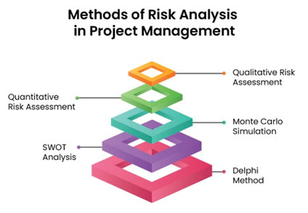
Chapter 7 : Risk Analysis and Management
Assit.prof. Juthawut Chantharamalee
Curriculum of Computer Science
Faculty of Science and Technology, Suan Dusit University

Slide 2
Software project
1. Vague requirement
2. User not sure of needs
3. Huge number of people
4. Large number of resources
5. Time span
6. Requirement changes

Slide 3
Core Risks
1. Ambitious time plan
2. Ambiguity in requirement
3. Requirement creep
4. Team turnout
5. Performance variance
Project manager

Slide 4
Software risk category
1. Project risk
2. Process risk
3. Product risk

Slide 5
Risk management process
1. Risk identification
2. Risk analysis
3. Risk planning
4. Risk monitoring
5. Risk resolving

Slide 6
Risk identification
1. Human resource
2. Organizational
3. Human resource
4. Tools
5. Estimation

Slide 7
Quantification of risk
Risk exposure
RE = Probability * consequence

Slide 8
Risk analysis
1. Questions
  What is causing the risk
  How much will it affect
  Are the risks dependent
  The probability that it will occur
  Is the exposure acceptable
2. Severity
3. probability

Slide 9
Risk planning
Avoidance
Protection
Reduction
Research
Reserves
Transfer

Slide 10
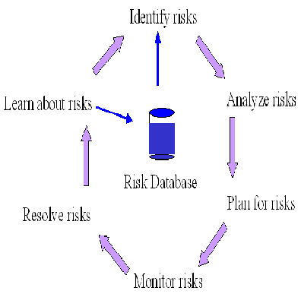
Risk management
Risk resolving
Risk documentation
Risk management

Slide 11
Levels of risk
1. Disaster management
2. Repair on failure
3. Risk mitigation
4. Prevention
5. Eliminate root cause

Slide 12
Finance and risk
Risk management poses extra expenses
Do we need this expense
  Medical insurance
  Spend on avoiding or solving

Slide 13
How much to spend
Risk exposure is considered
Is the risk exposure acceptable
Price versus budget
Which option to chose
  Cost
  Risk

Slide 14
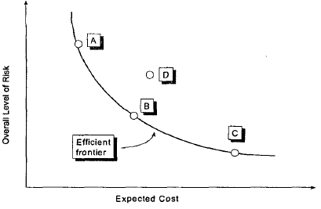
Risk efficient frontier

Slide 15
Conclusion
1. Managing risk is important
2. Correct quantification gives correct picture
3. Risk management with over all project view
4. Balance between cost and risk

Slide 16


